Slide 1

ACME Inc and Agile
By Sheldon Mattson

Slide 2
What is Agile
Umbrella term of methods and frameworks
Iterative approach to management and development
Frequent inspection and adaptation
Similar to Lean
Continuous improvement
Reducing defects and waste
Lean is about improving the process
Agile is about building better products

Slide 3
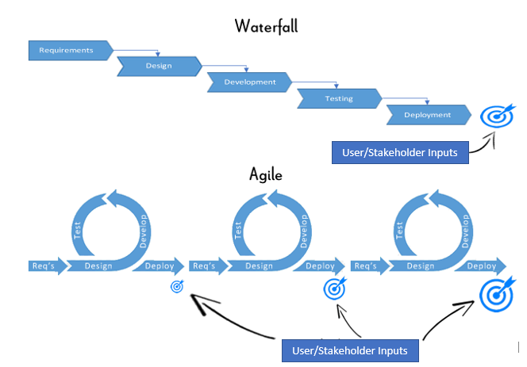
Agile vs Waterfall
Waterfall
Linear, sequential approach
Completed in phases
One testing phase
One big product
Limited feedback
Limited scope
Agile
Iterative approach
Completed in sprints
Frequent testing
Cumulative product deployment
Frequent feedback and collaboration
Adaptable scope

Slide 4
Why Agile
More cost effective
Increases team engagement and motivation
Increases efficiency
Cumulative product deployment
Adptability

Slide 5
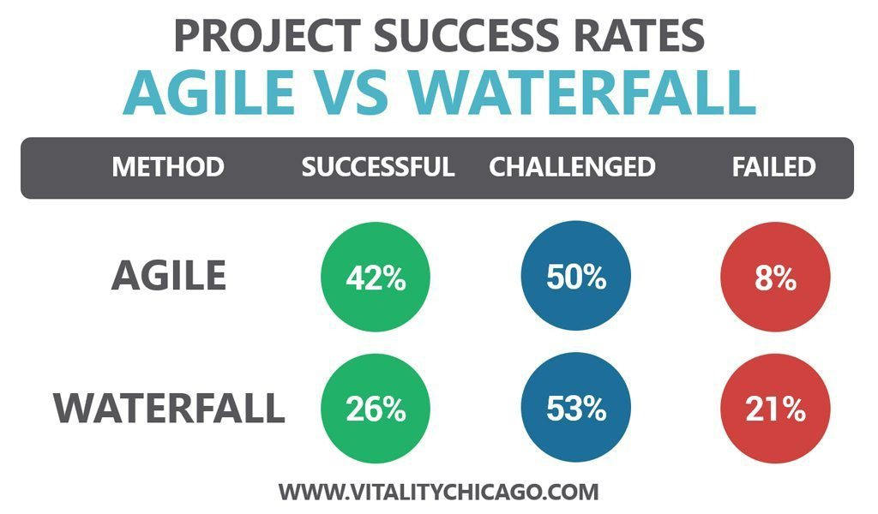
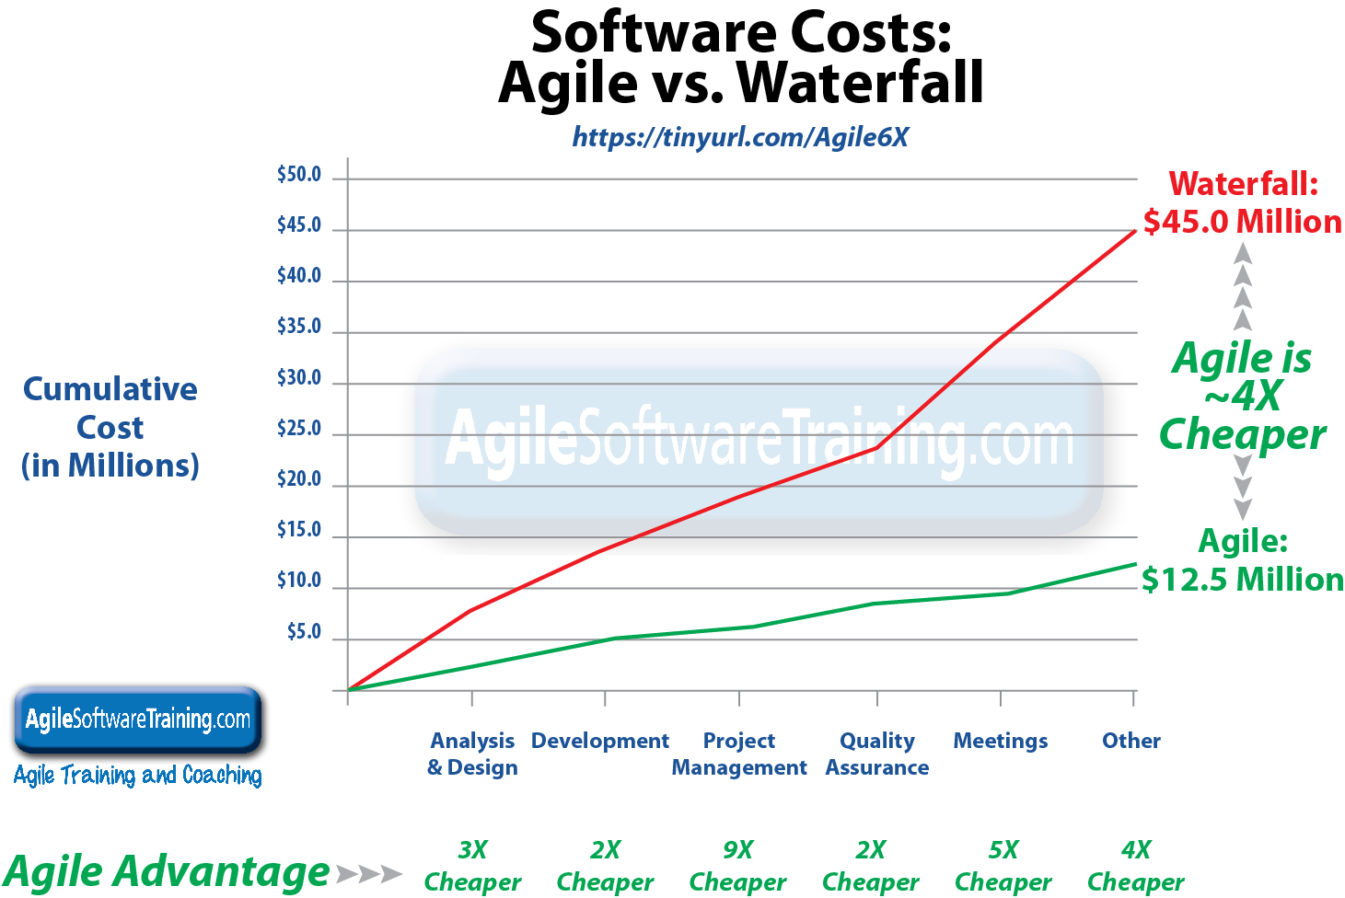
2018 Survey by Standish Group Chaos Study
3 constraints
Schedule
Cost
Scope
Benefits of Agile
2015 Survey by Standish Group Chaos Study

Slide 6
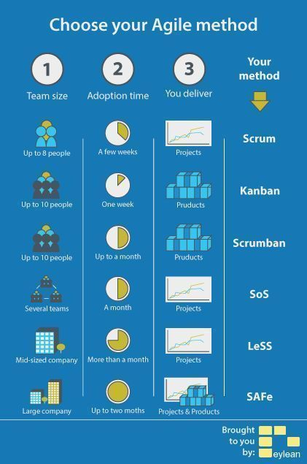
Adopting Agile
There are a variety of different methods to scaling Agile
SOS and LeSS are based on Scrum
SAFe allows for different teams to choose their methodology
Scrum is the most common method and is the recommended method for ACME

Slide 7
Scrum Organization
Roles
Scrum Master
Removes impediments and distractions
Encourages and supports
Product Owner
Backlog development and management
Maximize ROI
Development team
Self-organizing
Defines each sprint
Meetings
Sprint planning
Beginning of every Sprint
Develop backlog
Communicate goal
Daily scrum
Timeboxed: about 10-15 minutes
Discuss what was accomplished, today’s tasks, and identify impediments
Sprint Review
Demonstrate product functionality
Sprint Retrospective
Review what went right and wrong
Identify and reflect on improvements

Slide 8
Two Pizza teams (5-9 members per team)
Feature teams over Component teams
Reduce multitasking
Take into account geographic and cultural differences
Start meetings with discussions, such as the news
Set a strict limit for meetings
Foster a “safe to fail” environment
Learn from rather than punish mistakes
Team Building Strategies

Slide 9
Thanks

